Slide 1

P-224 GROUP-5 Presenting
Bike Rental Prediction
Project Mentor
Mrs. Aishwarya mate
Presented By
Mr. Lokesh B S
Mr. Manoj J
Mr. Karthik Siga
Mr. Pushpendra Raj
Mr. Ganesh Singh
Mr. Abhishek R Chinchole
Mr. Rupak Dipak Mondal

Slide 2
Objectives
The objective of this project is to Predict the demand (Count) for bike rentals based on various factors such as time of day, weather conditions, holidays, and other factors that may influence bike rental patterns. This can help bike-sharing companies to manage their resources more effectively and provide better services to their customers.

Slide 3



Project Architecture / Project Flow
Model Deployment
Evaluation of Finalize Model
Model Building
Feature Selection
Exploratory data analysis (EDA)
Data Preprocessing
Creating Project Flow
Understanding Data

Slide 4
Project Flow
1. **Data Collection:**
Collect the data from various sources such as bike-sharing companies, weather stations, and other relevant sources. [Already Provided] 2. **Data Cleaning and Preparation:**
Perform data cleaning and preparation tasks such as
- Imputing missing values
- handling outliers
- transforming data to make it suitable for analysis. 3. **Exploratory Data Analysis (EDA):**
- Conduct exploratory data analysis to gain insights into the data with visualization like barplots.
- Finding the correlation between the features and how they influence they other features.
- Also identify patterns and relationships, and select relevant features. 4. **Feature Engineering:**
Select features from the existing ones that may help in improving the predictive power of the model. 5. **Model Building:**
Build machine learning models using various algorithms such as
- linear regression
- decision trees
- random forest
- SVR
- Gradient Boosting
- K-Nearest Neighbors regression 6. **Model Evaluation:**
Evaluate the performance of the model using various metrics such as
- mean squared error (MSE)
- R-square Score 7. **Model Tuning:**
Fine-tune the model by adjusting Hyperparameters using RandomsearchCV to improve its performance. 8. **Deployment:**
Deploy the model to production and monitor its performance over time.

Slide 5
Details of the dataset (Columns) provided
Dataset Dictionary:
Instant --> Index number
Dteday --> Date (Format: YYYY-MM-DD)
Season --> Season Name
Yr --> Year
Month --> Month (1-12)(Jan-Dec)
Hr --> Hour(0 to 23)
Holiday --> Whether the holiday is there or not
Weekday --> Day of the week
Workingday --> Whether it is a working day or not
Weathersit --> Weather situation
Temp --> Normalized temperature in Celsius
Atemp --> Normalized feeling temperature
Hum --> Normalized humidity. The Values are divided by 100
Windspeed --> Normalized Wind speed. Values are divided by 67
Casual --> Count of casual users
Registered --> Number of registered users
Cnt --> Count of total rental biked including both casual and registered

Slide 6
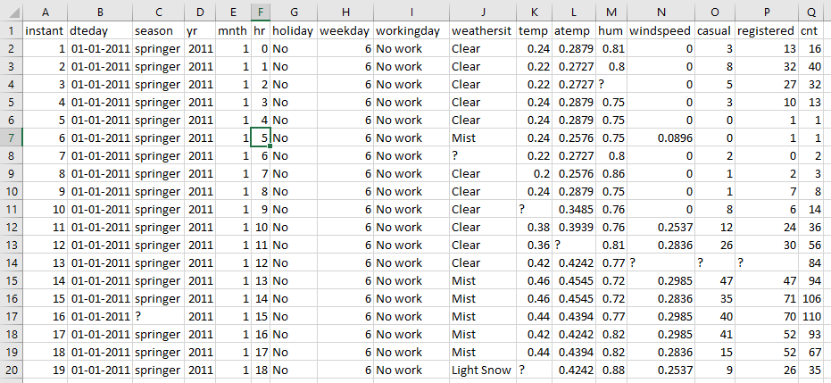
About Dataset :
The data set is the observation of behavior of people hiring bikes with respect to different aspects.

Slide 7
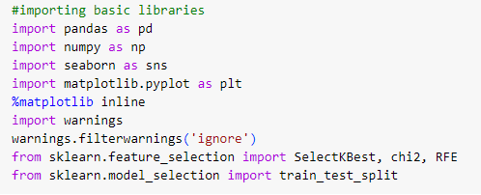
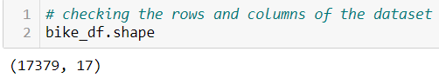
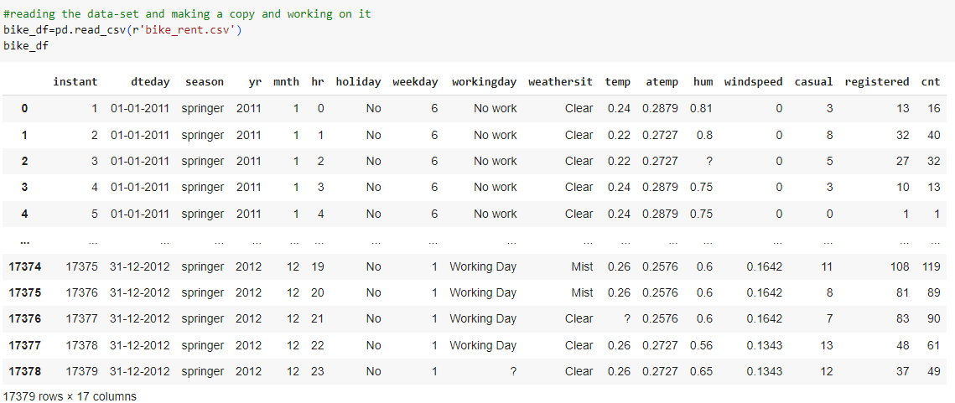
Importing Necessary Libraries And Reading The Data Set And Checking For Basic Requirements
Our dataset contains 17379 rows & 17 Rows

Slide 8
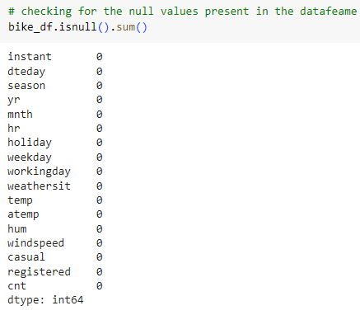
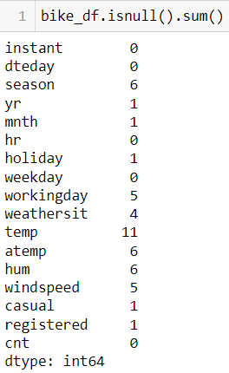
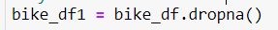
More Details About Dataset
There are no null values found, but through observation we can make out that there are null values in the form of “?”. Therefore, we replace it with “NaN” and consider it as missing values
At 1st when we checked the number of null values present we don’t get any null/missing values
As we can see that according to our dataset we have very few null values so we choose to drop the null values

Slide 9
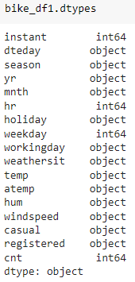
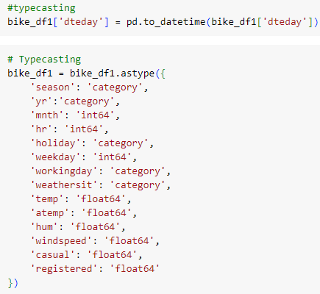
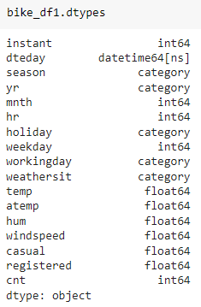
We can see that almost every column is of “object ” data type
Therefore Performed Typecasting to change the datatype of the each columns

Slide 10
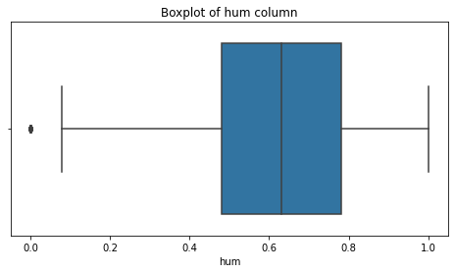
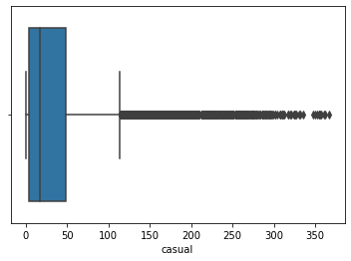
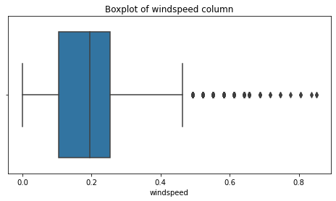
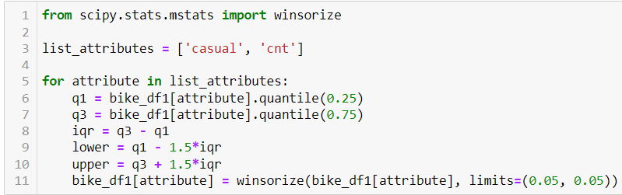
Outlier Analysis Using Boxplot
By doing outlier analysis we detected outlier from 3 columns i.e. “hum”,”casual”,”windspeed”.
We have treated the outlier using Winsorizing Method
This process involves replacing the extreme values with the next highest or lowest value within a specified range.
This code loops through the list of attributes and for each attribute, it calculates the IQR and the upper and lower bounds for outliers.
It then uses the winsorize function from scipy.stats.mstats to winsorize the data for that attribute with a limit of 5% on each side.

Slide 11
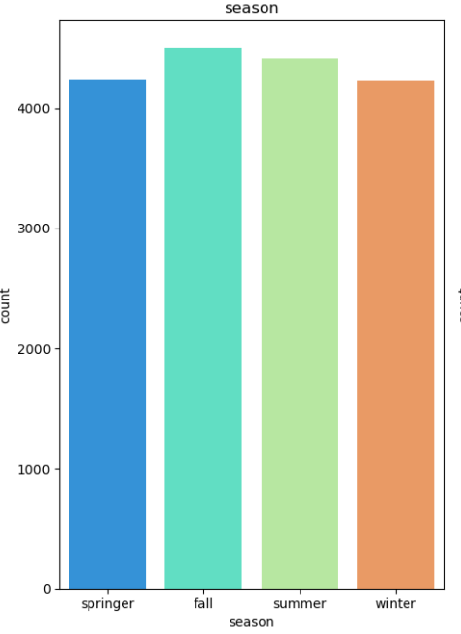
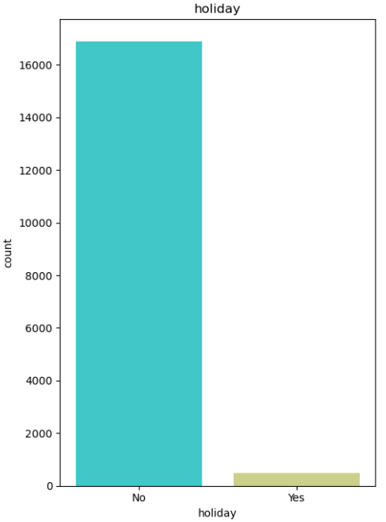
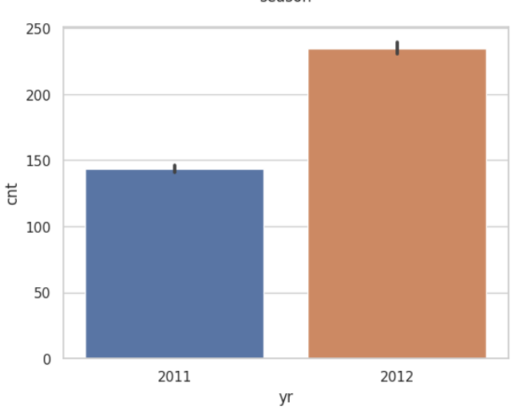
Visualization
Total bikes rented are more in Year 2012.
Total bikes rented are more in fall season, and next comes the winter and summer.
Bikes rented are maximum on non-holiday days.

Slide 12
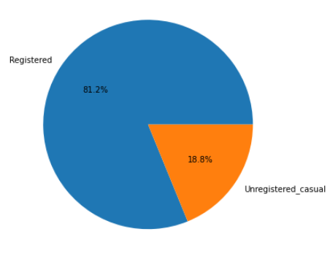
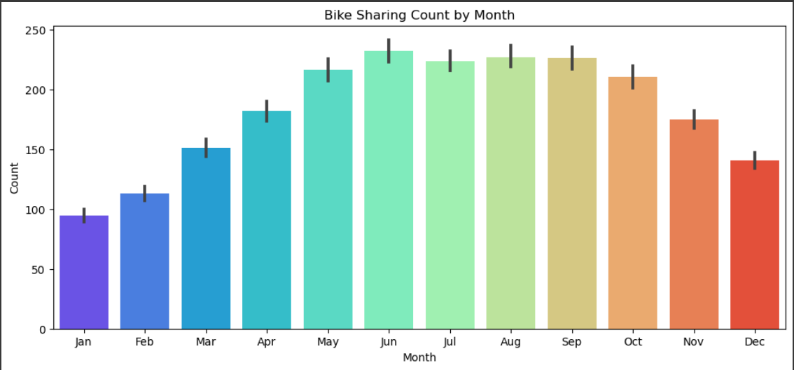
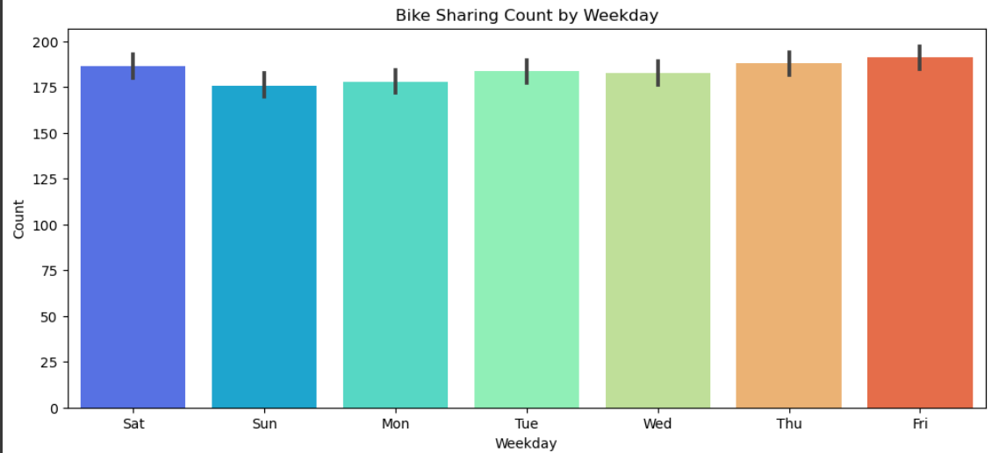
Visualization
Most of the customers are Registered user
Bikes rented are at maximum in the month of June followed by Aug, Sep and July.
The bike rental was similar on almost all days, maximum on Saturday

Slide 13
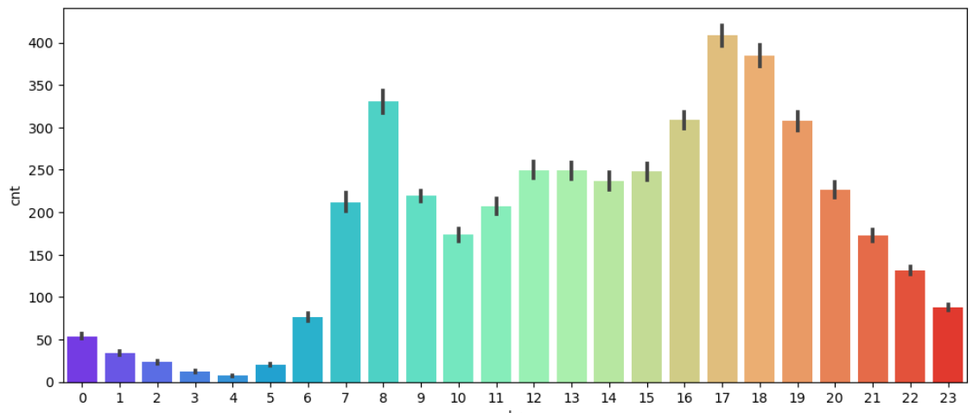
Plot Showing The Bike Rental Count By Every Hour
From this We can see that maximum number of bike rental count by every hour is on 17th & 18th Hour

Slide 14
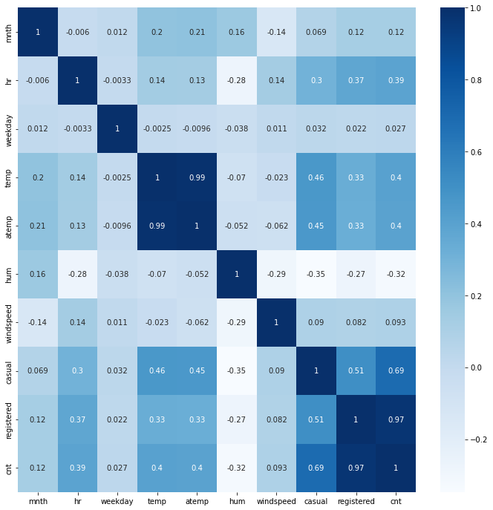
Correlation Plot
1. Registered column and Cnt column are highly correlated (0.97).
2. Temp column and Atemp column are also highly correlated (0.99).
3. Cnt column are also strongly correlated with casual column (0.69).
4. Cnt column is negatively correlated with hum column(-0.32) and holiday column (-0.03).
5. Temp and Atemp are positively correlated with cnt column (0.4)

Slide 15
Feature Selection
We have performed Multiple Feature Selection Method
1. Correlation
2. Chi2
3. Information Gain
4. RFE - logistic Regression
5. RFE - Decision Tree

Slide 16
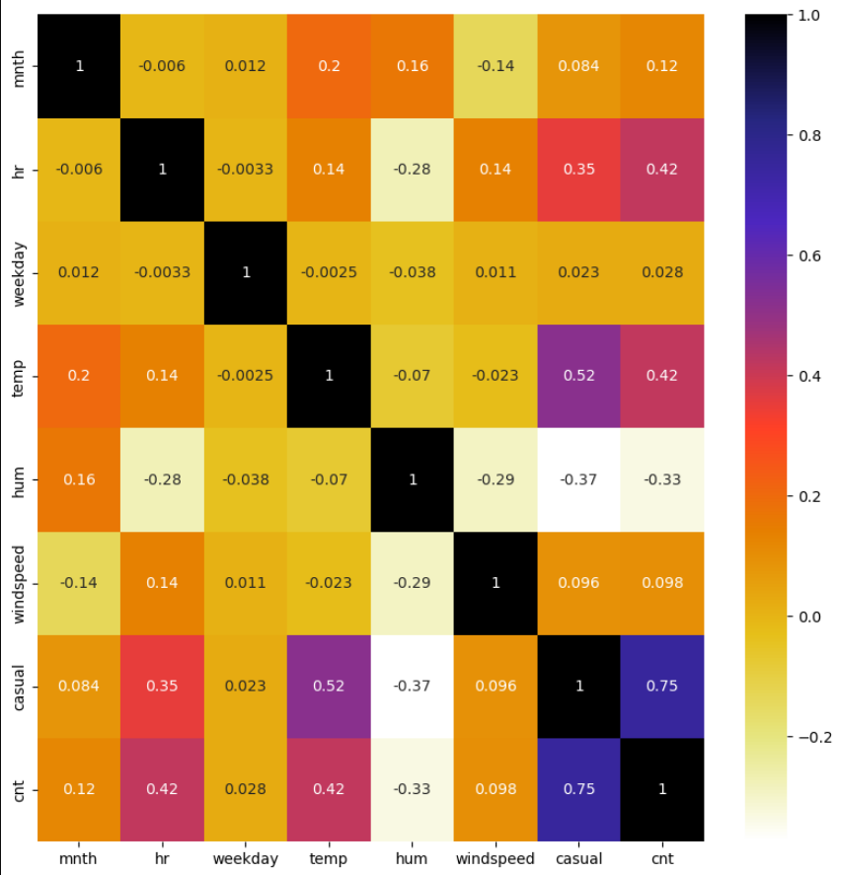
CORRELATION
There are no columns which are correlated to each other. i,e; All the columns are unique and important.

Slide 17
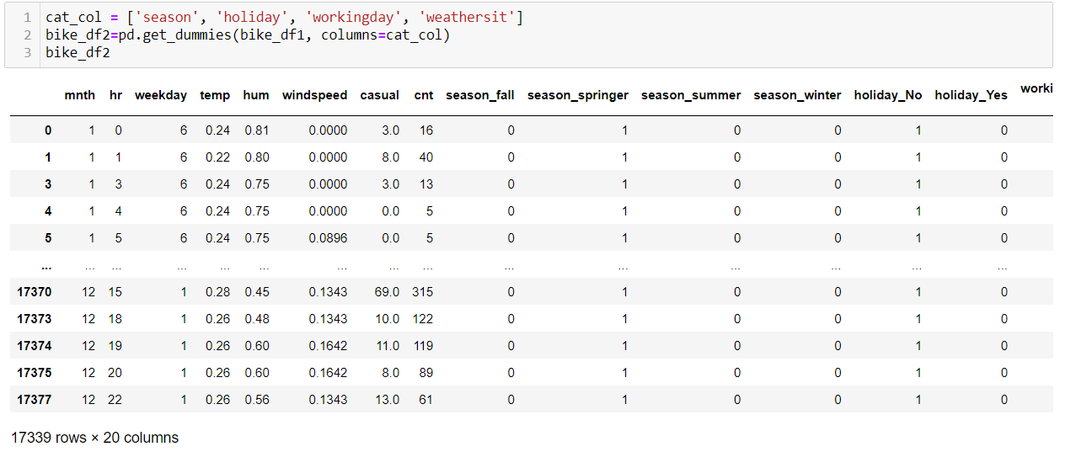
Encoding Categorical Columns
We have used One-Hot Encoding for Encoding Categorical Columns

Slide 18
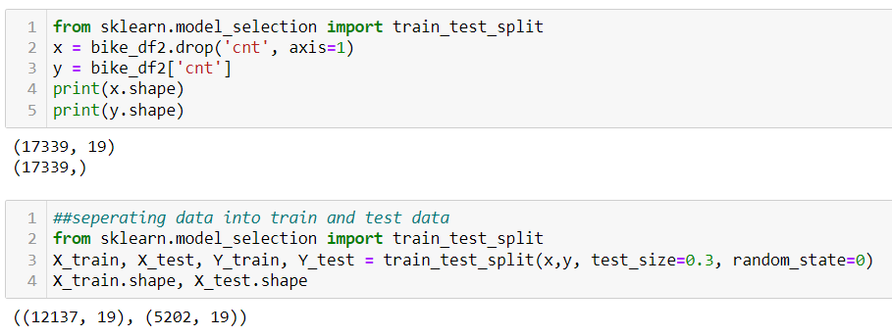
Data Splitting
We have split our data into 70% as Train & 30% as Test Dataset

Slide 19
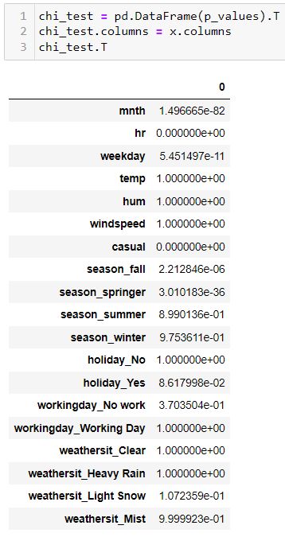
Feature Selection using Chi2
The Chi2 test show all features(excludes hr and casual) which can be used for further analysis.

Slide 20
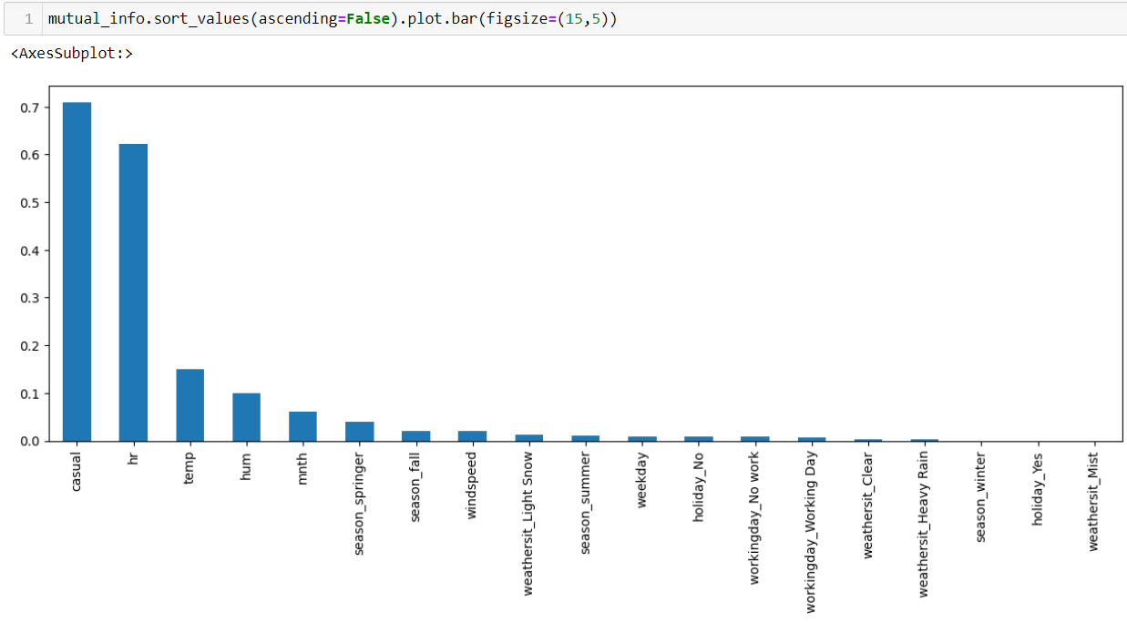
Information gain - Mutual information In Regression
Mutual information In Regression - Here only 4 features are selected as shown above
['hr', 'temp', 'hum', 'casual']

Slide 21
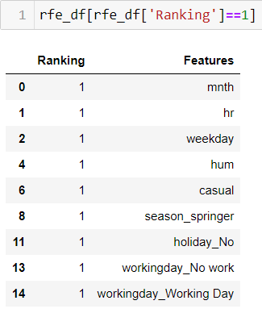
RFE (Recursive Feature Elimination) With Logistic regression
Recursive Feature Elimination with Logistic regression show 9 columns which can be used for further analysis
Selected Columns :- 'mnth','hr','weekday', 'hum','casual','season_springer','holiday_No','workingday_No work','workingday_Working Day'.

Slide 22
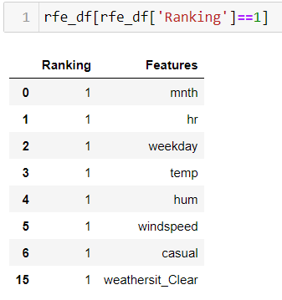
RFE (Recursive Feature Elimination) With Decision Tree
Recursive Feature Elimination with Decision Tree show 7 columns which can be used for further analysis
Selected Columns :- 'mnth', 'hr', 'weekday', 'temp', 'hum', 'windspeed', ‘casual’

Slide 23
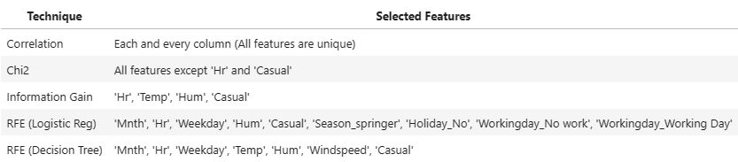
Here’s the conclusion of our all the feature selection techniques
'mnth', 'hr', 'weekday', 'temp', 'hum', 'windspeed', 'casual', 'cnt','season_fall', 'season_springer', 'season_summer', 'season_winter', 'holiday_No', 'holiday_Yes', 'workingday_No work', 'workingday_Working Day', 'weathersit_Clear', 'weathersit_Heavy Rain', 'weathersit_Light Snow', 'weathersit_Mist'

Slide 24
Model building
In our Project We have used Many Regression Models, Further we choose the model with highest Accuracy & lowest MSE score value as Our Final Model
Model Name | ON TRAIN DATA |  | ON TEST DATA
 | R-squared Value | MSE | R-squared Value | MSE
Linear Regression | 0.6401 | 9664.9886 | 0.6511 | 9598.8888
Decision tree Regression | 1.0000 | 0.0000 | 0.8499 | 4129.4396
Random Forest Regression | 0.9886 | 306.4663 | 0.9248 | 2068.7012
Gradient Boosting Regression | 0.7209 | 7496.0020 | 0.7247 | 7572.9106
K-Nearest Neighbours Regression | 0.8999 | 2688.6388 | 0.8487 | 4161.0009
Support Vector Regression | 0.5876 | 11546.9545 | 0.5954 | 11128.8912

Slide 25
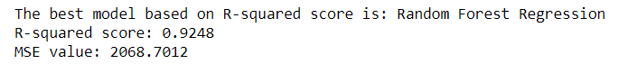
Model Selection
For Model selection we have created a dict and stored the R-squared scores and MSE of Each model and then found the Best performing model based on R-squared and MSE values
We have used RandomsearchCV for finding the best Hyperparameters
After this we Rebuild the model With the Best parameters & Evaluated the the score

Slide 26
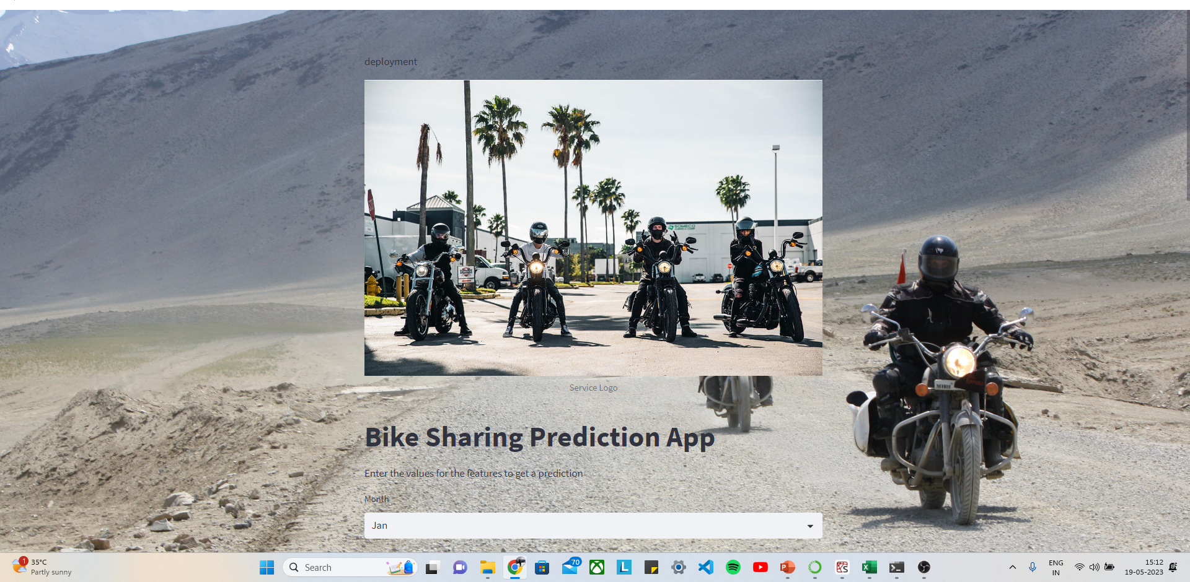
Deployment using streamlit

Slide 27
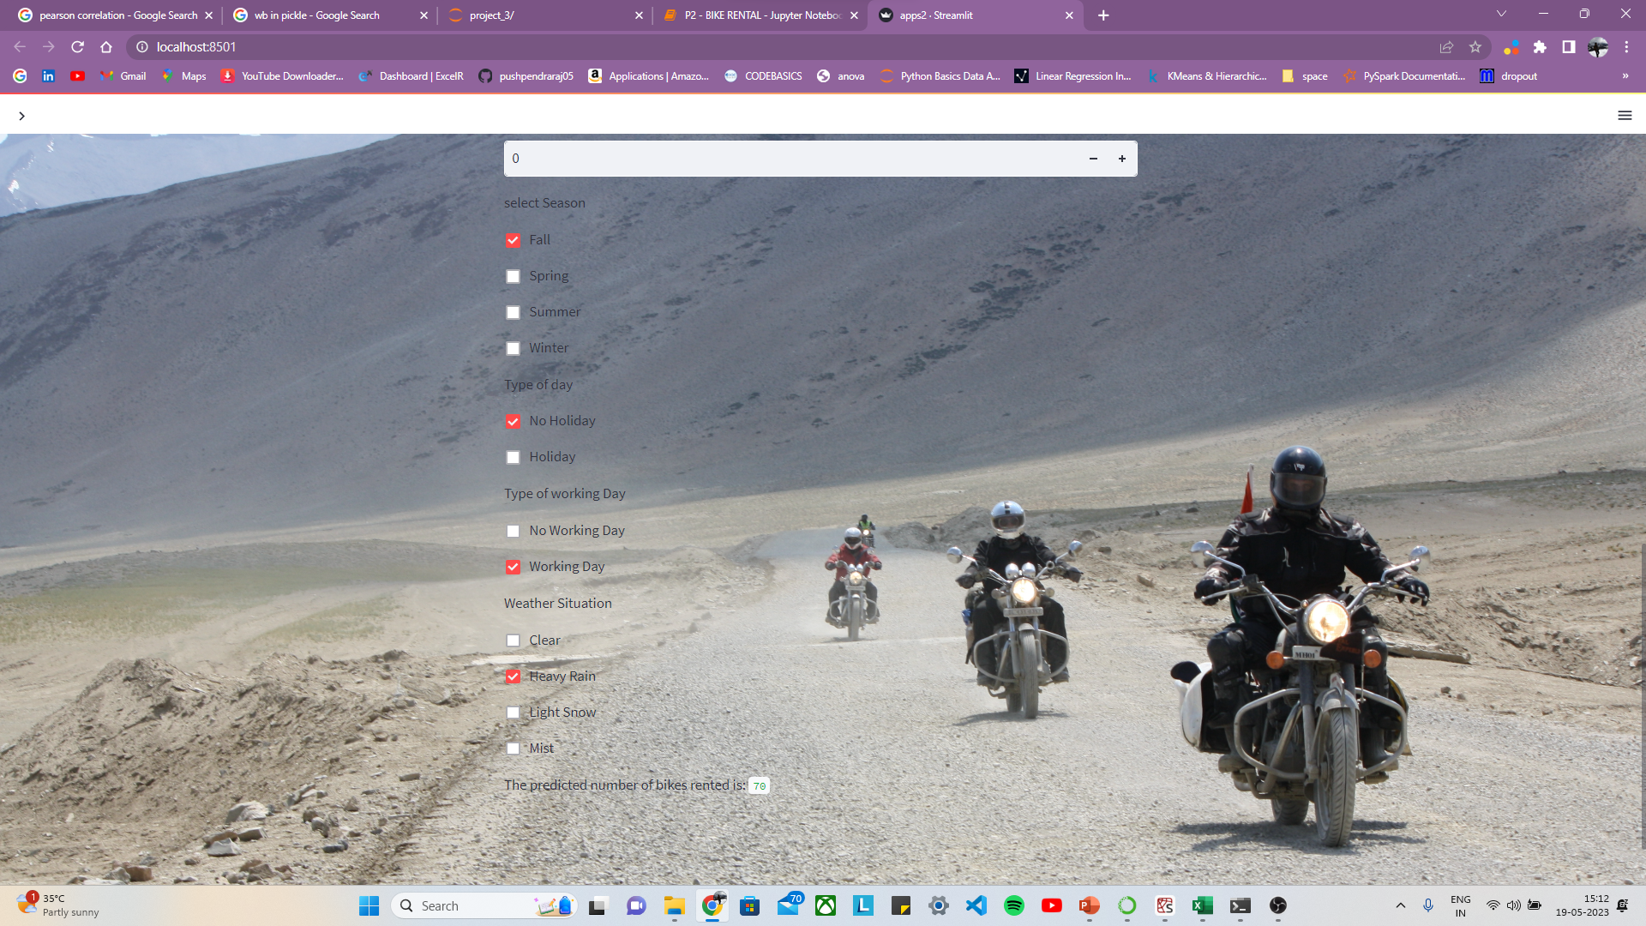
Deployment using streamlit

Slide 28
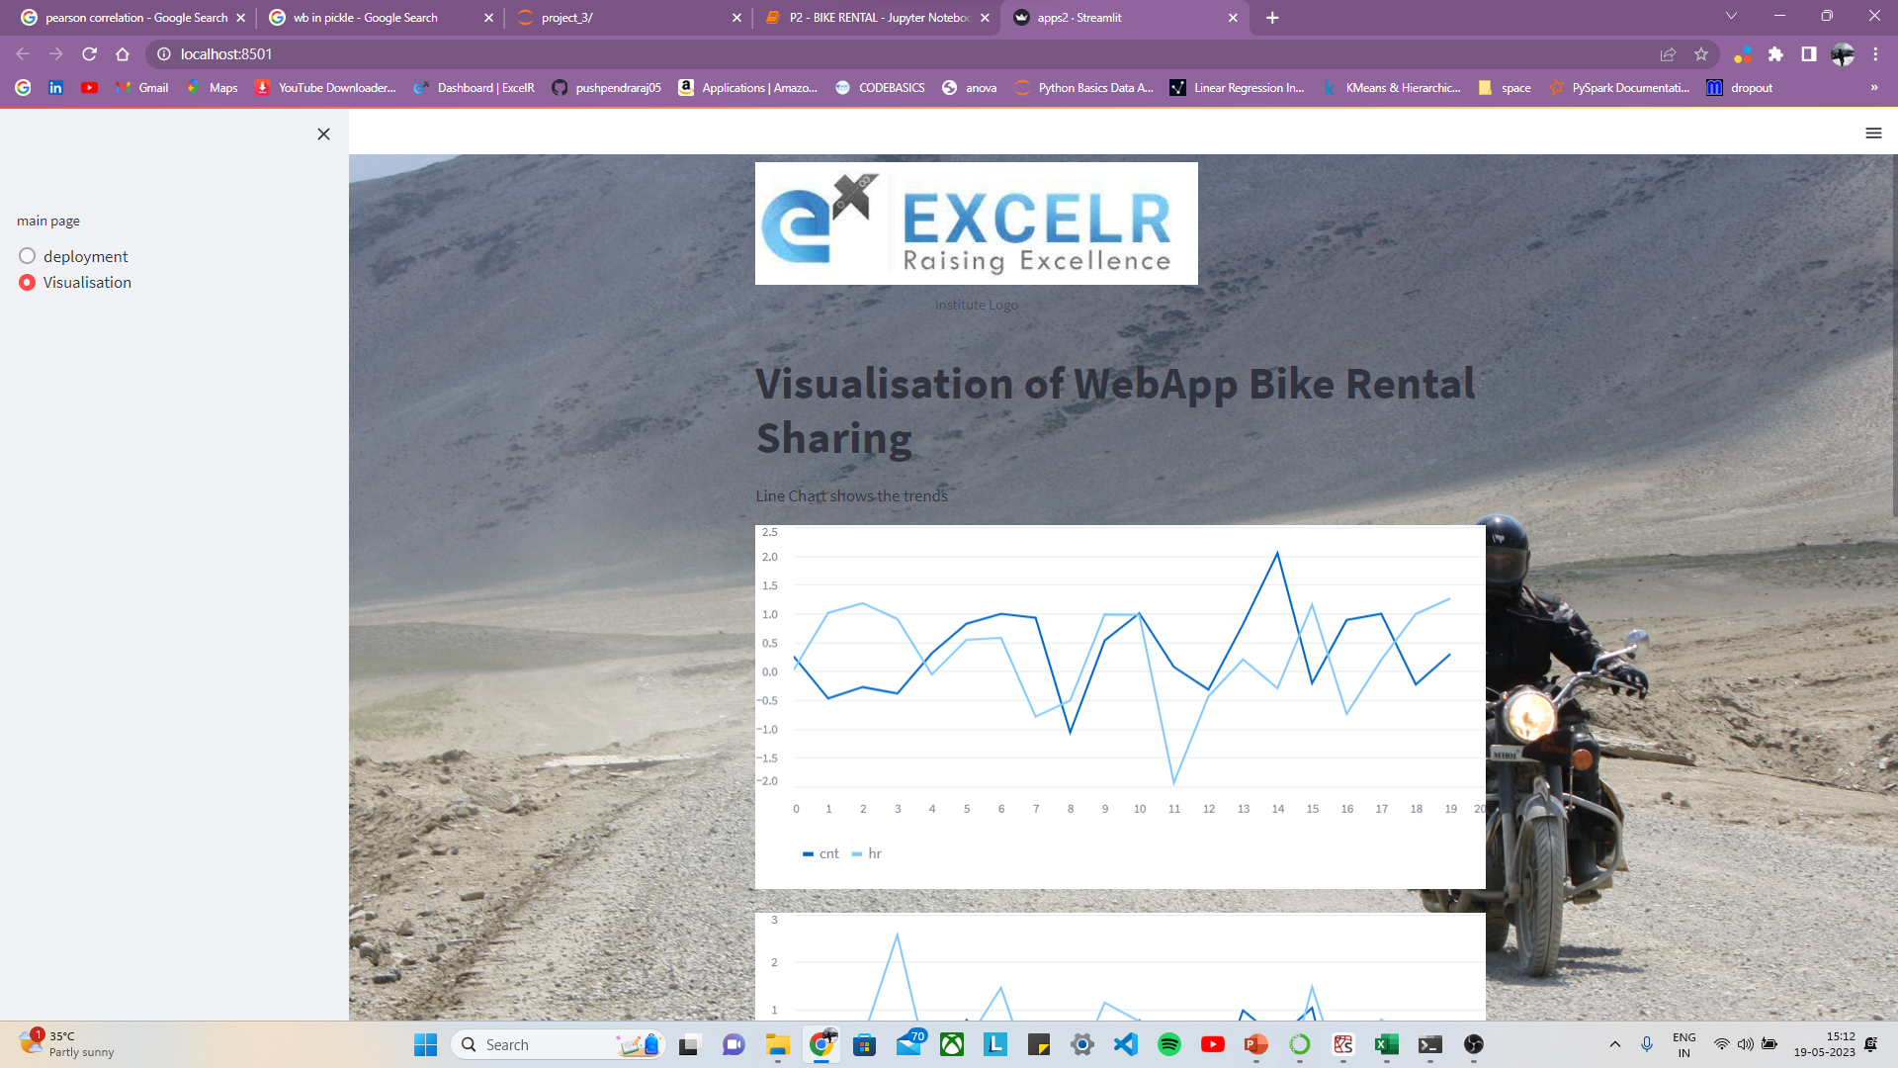
visualisation

Slide 29
THANK YOU

